Slide 1
Agenda:
1. Figure out the reason for the poor performance of DR learner and g computation for some scenarios
2. How to improve the performance of causal forest with big sample size (>= 2000)?
- Does tune. parameters/super learner influence the doubly robust scores we got from causal forest?
3. Discuss the blp performances
- Do we need to come up with a function for the relationship between blp and other parameters, including sample size, level of heterogeneity and number of confounders?
4. Discuss next steps for implementing Aim 2: evaluate how well each algorithm can identify potential effect modifiers out of a set of covariates that includes modifying and non-modifying variables.

Slide 2
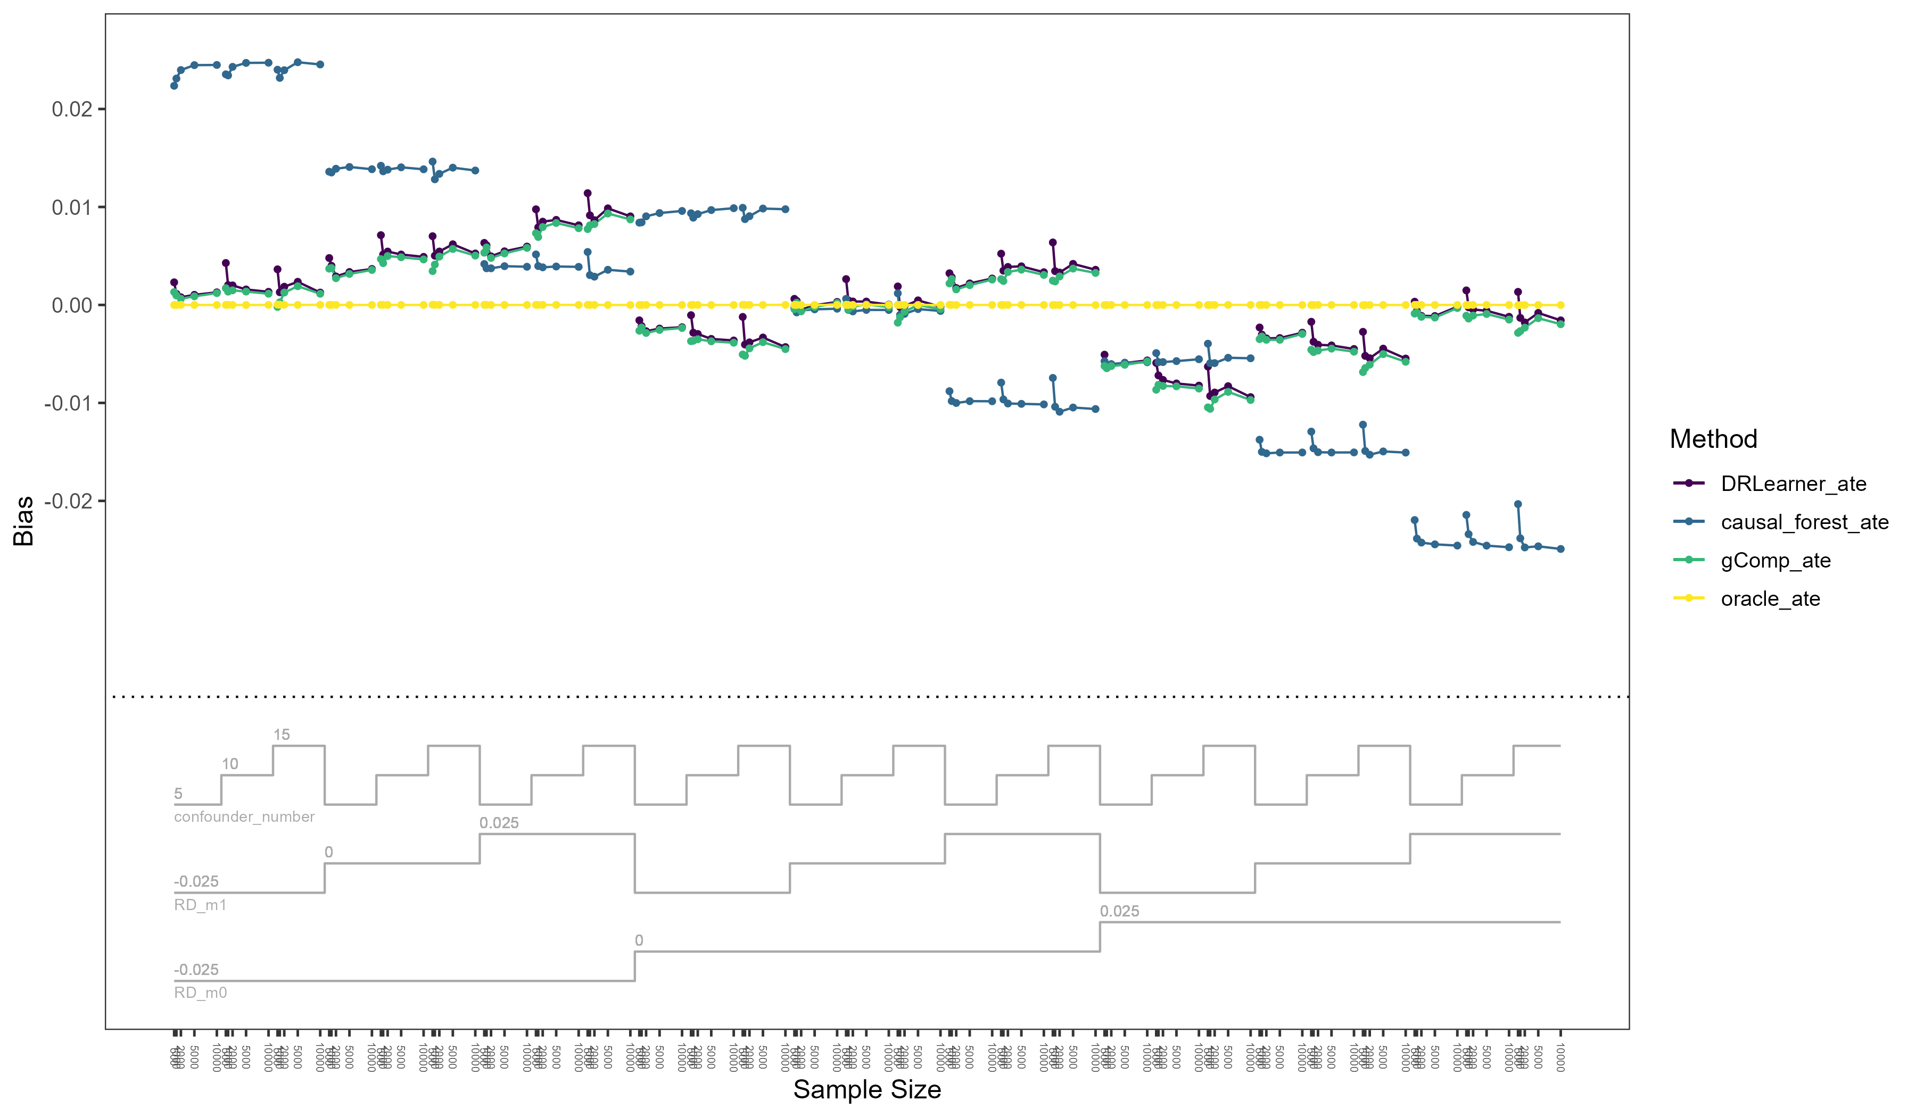

Slide 3
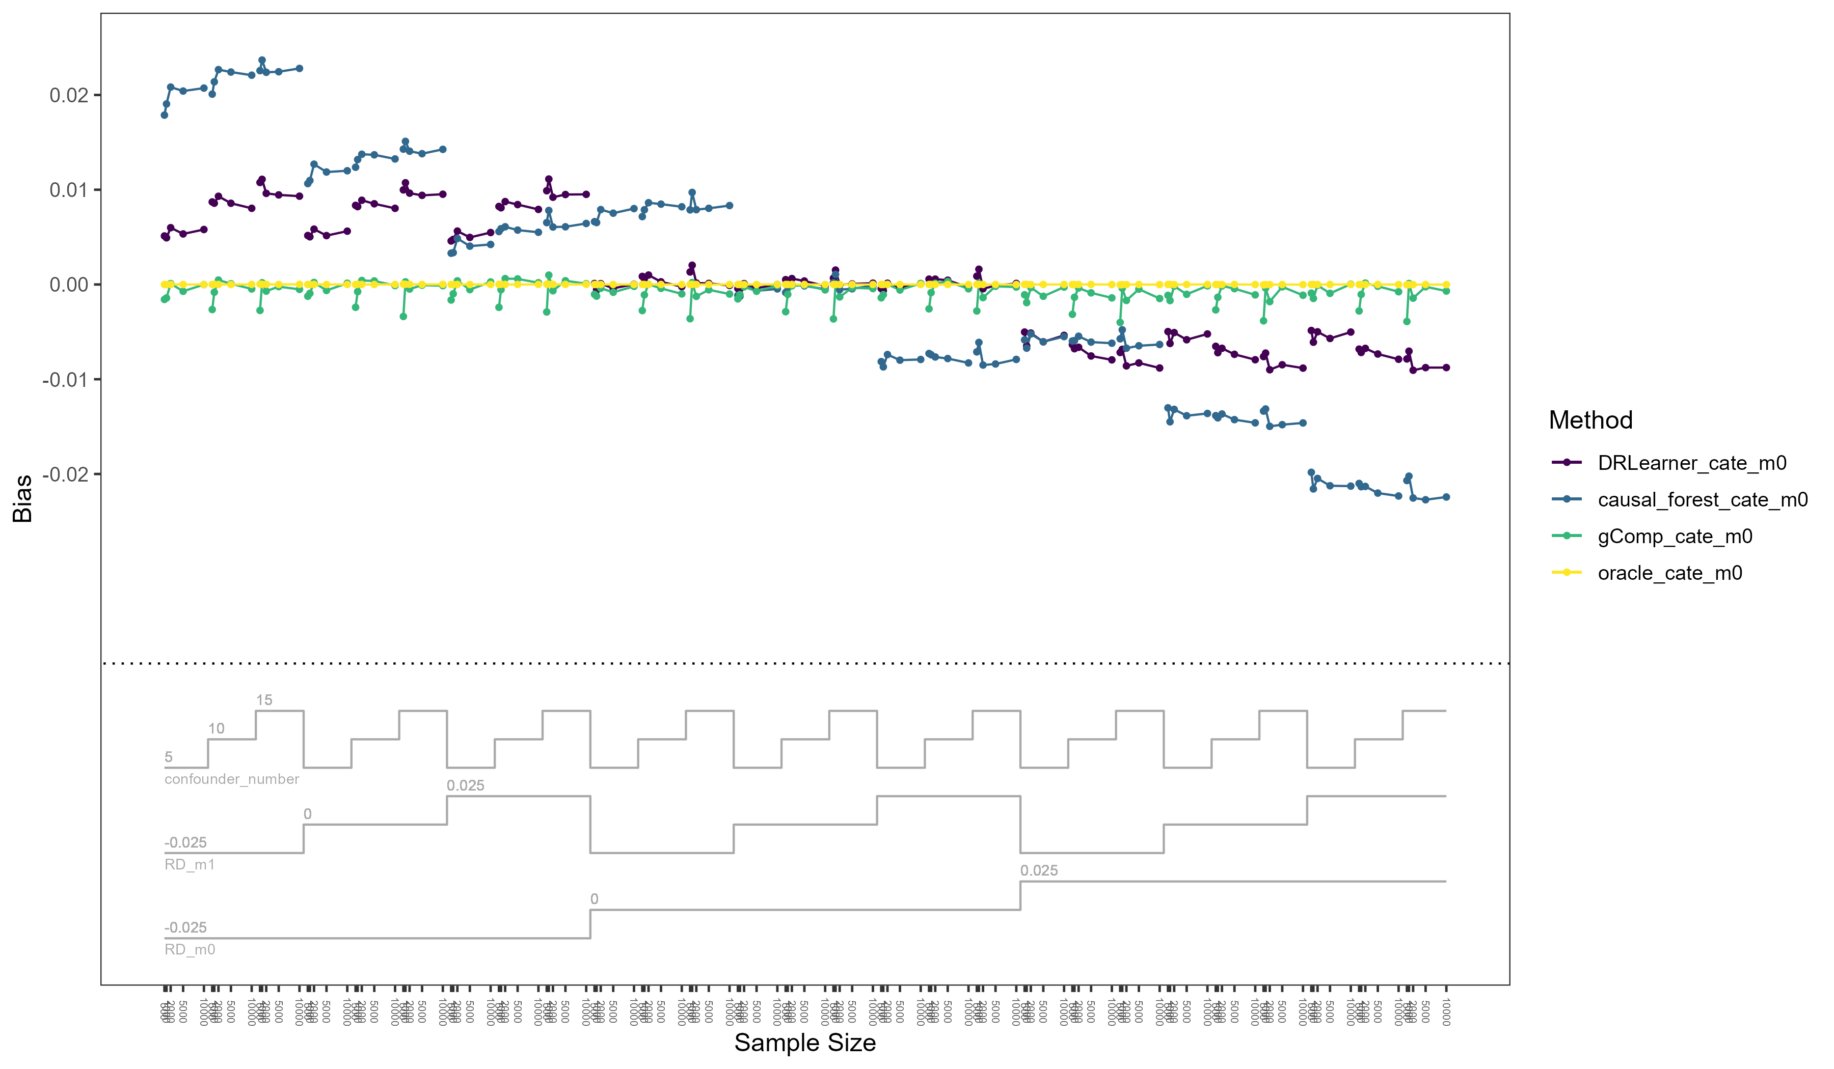

Slide 4
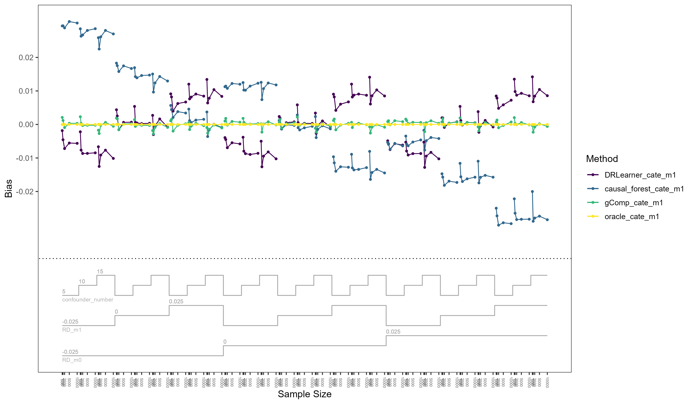

Slide 5
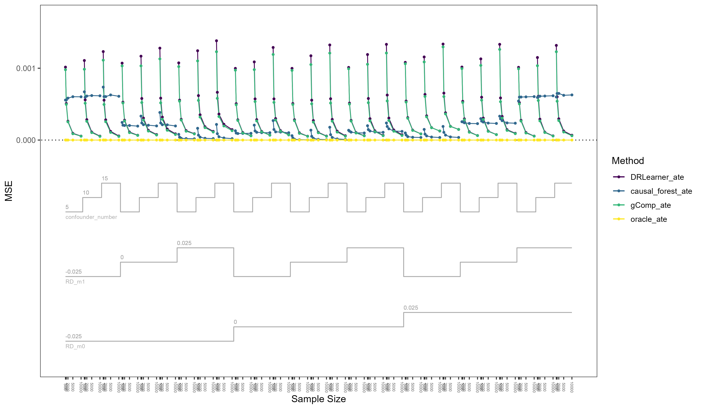
Notes:
The confounding effects outweigh the effect of level of heterogeneity
Use RMSE to replace MSE for figures

Slide 6
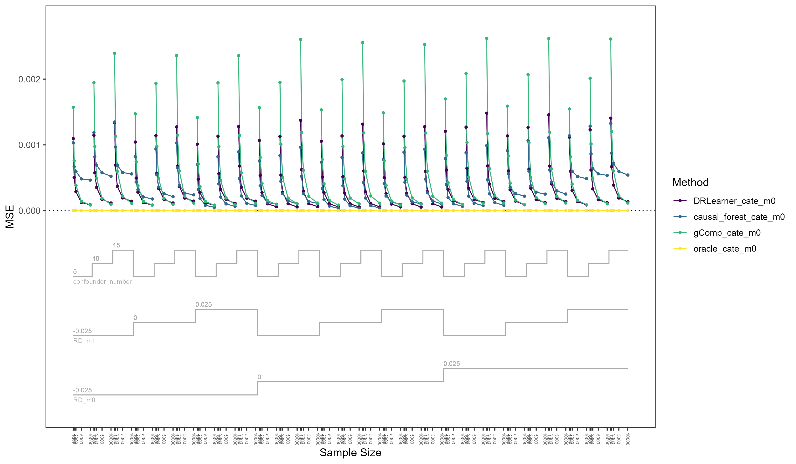

Slide 7
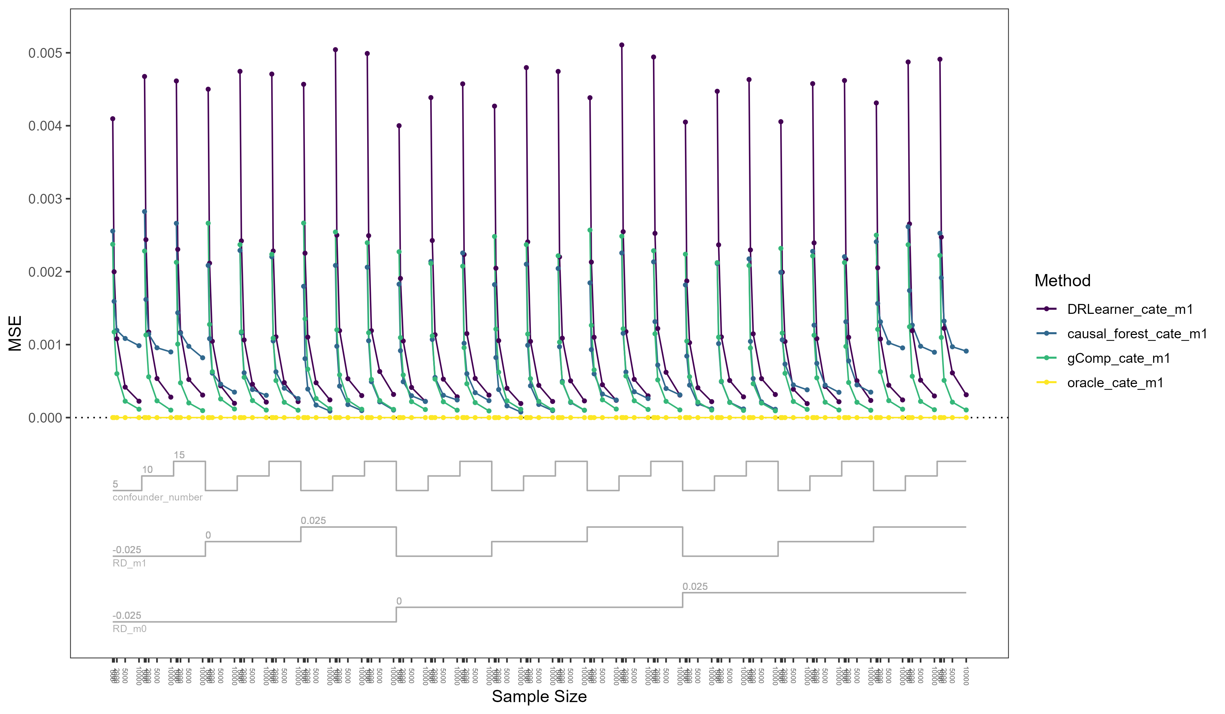

Slide 8
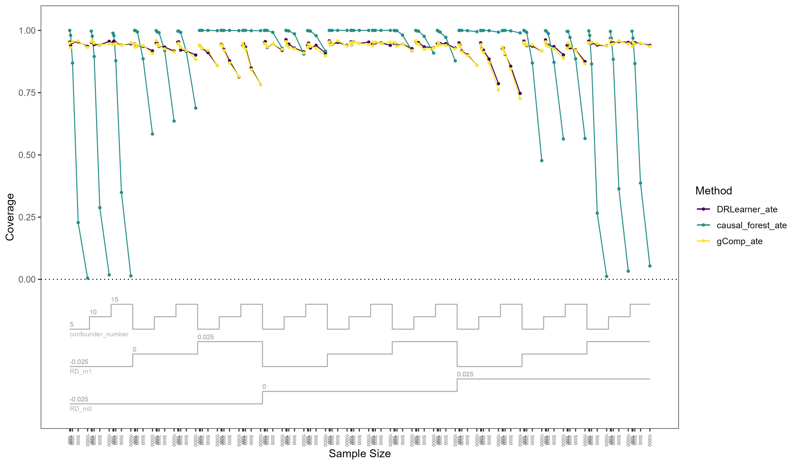
Notes:
Make the color consistent: remove yellow
Add the line of 0.95
Bias is driving the decrease of coverage

Slide 9
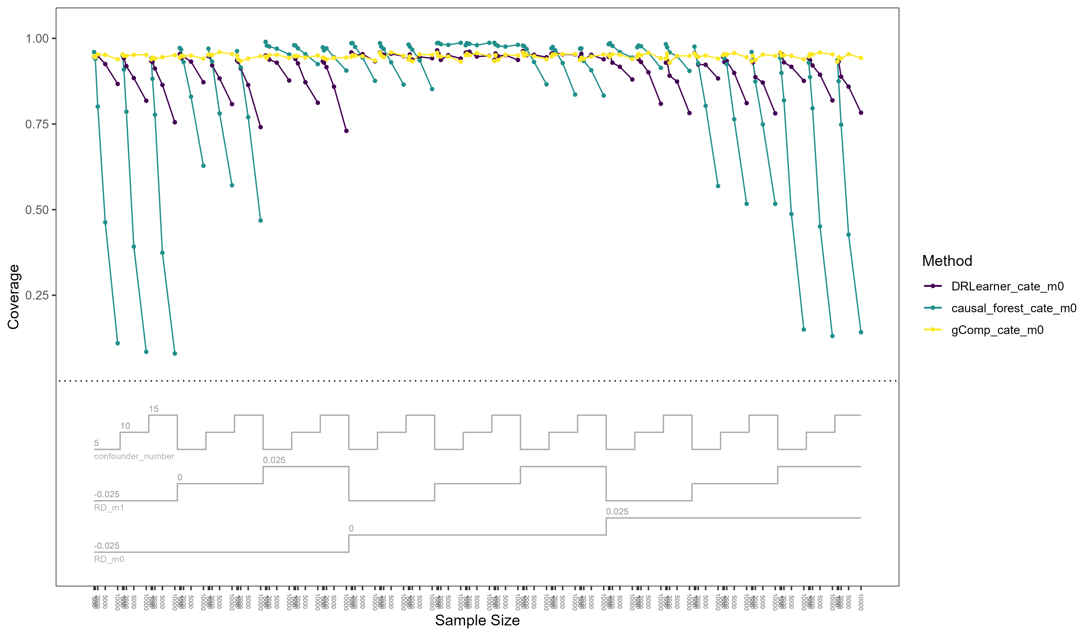

Slide 10
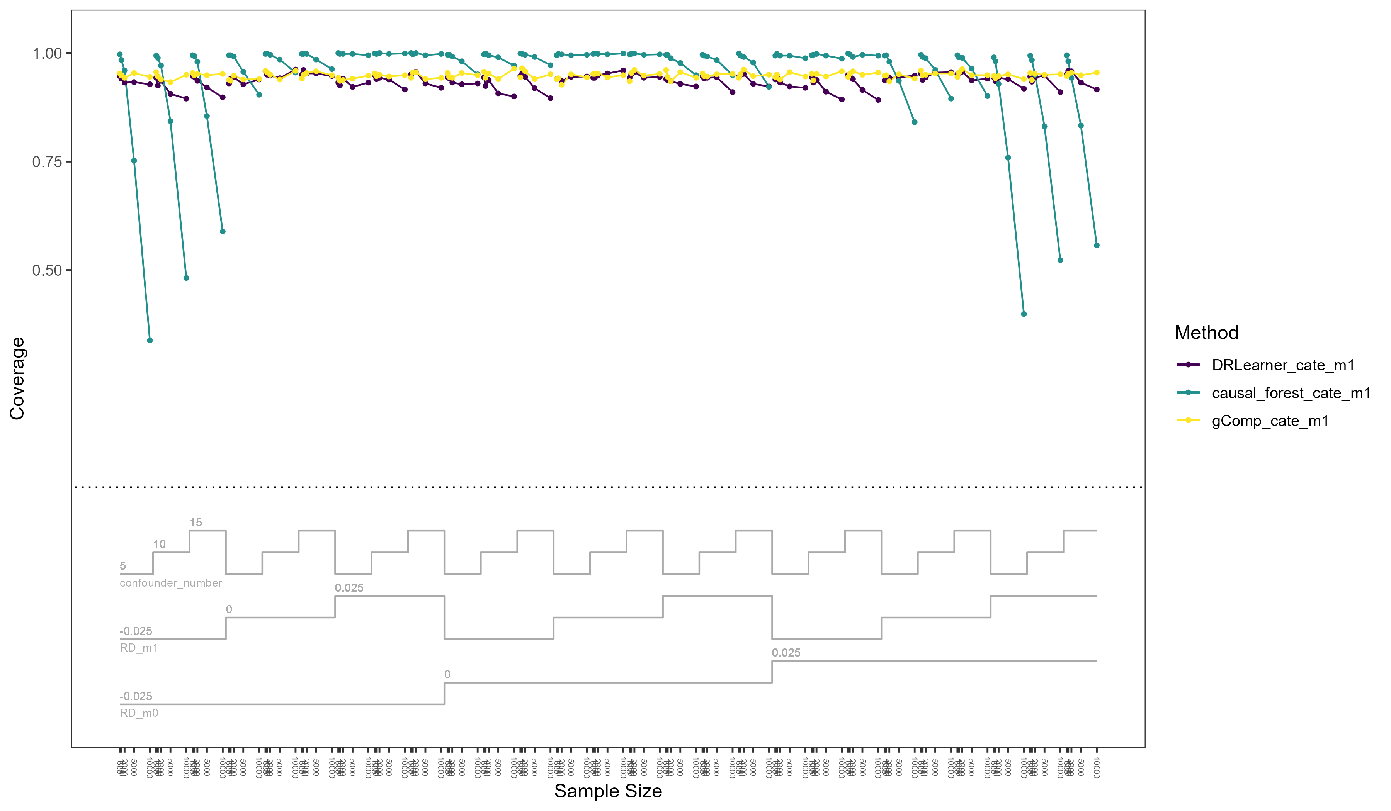

Slide 11
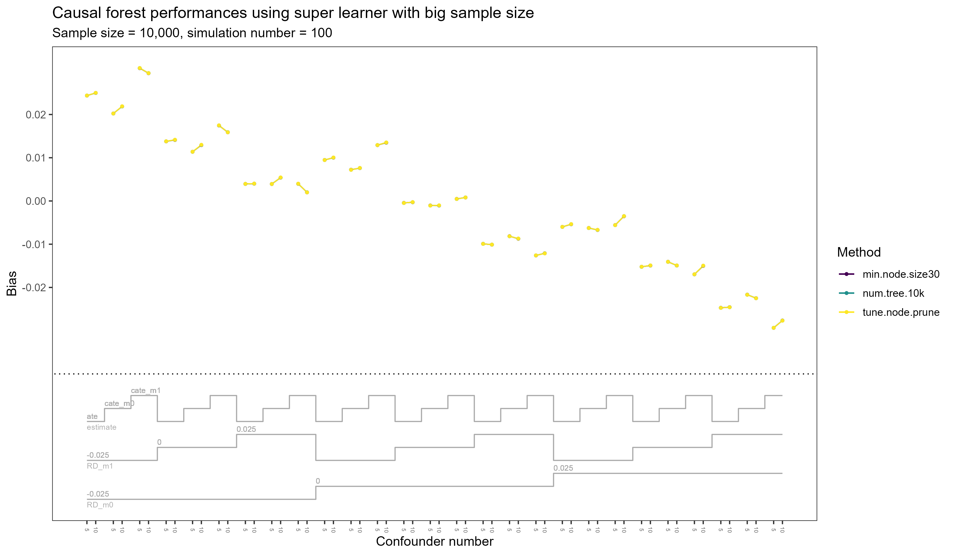
Notes:
Causal forest, consider three scenarios:
Super learning: what this will change in terms of causal forest procedures
Tune = all
Specify tuned parameters
Q: relationship between tau and AIPW scores
Potential: write our own causal forest algorithm

Slide 12
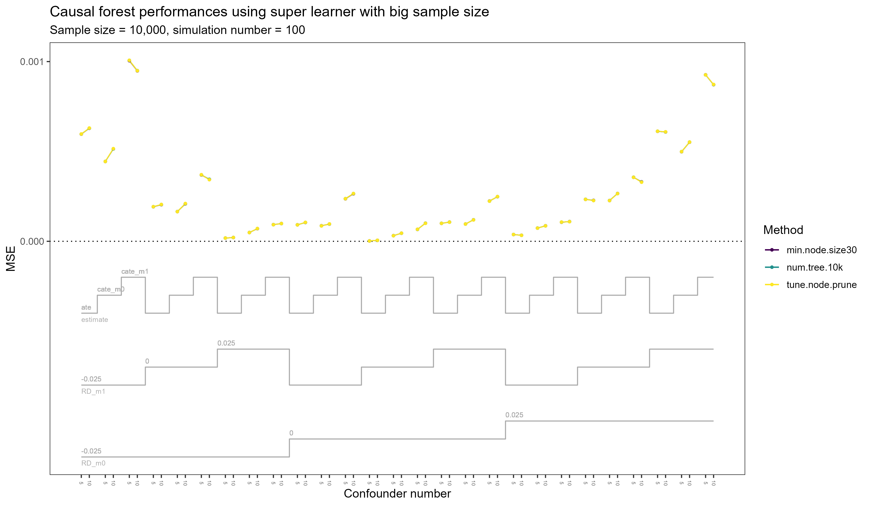

Slide 13
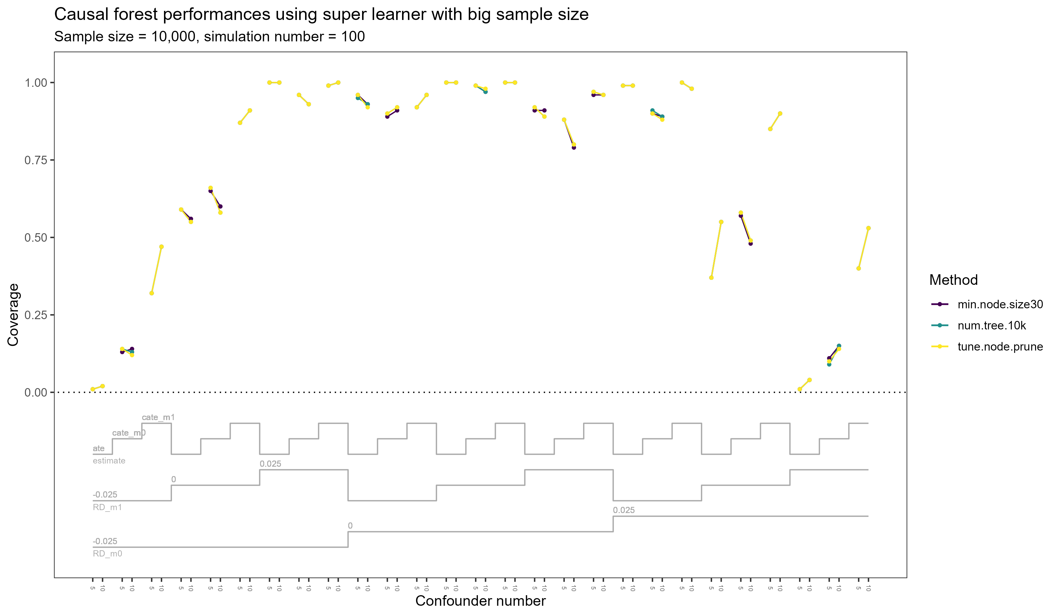

Slide 14
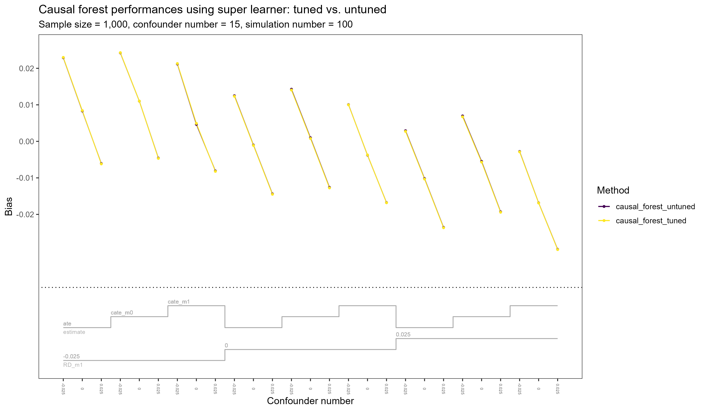

Slide 15
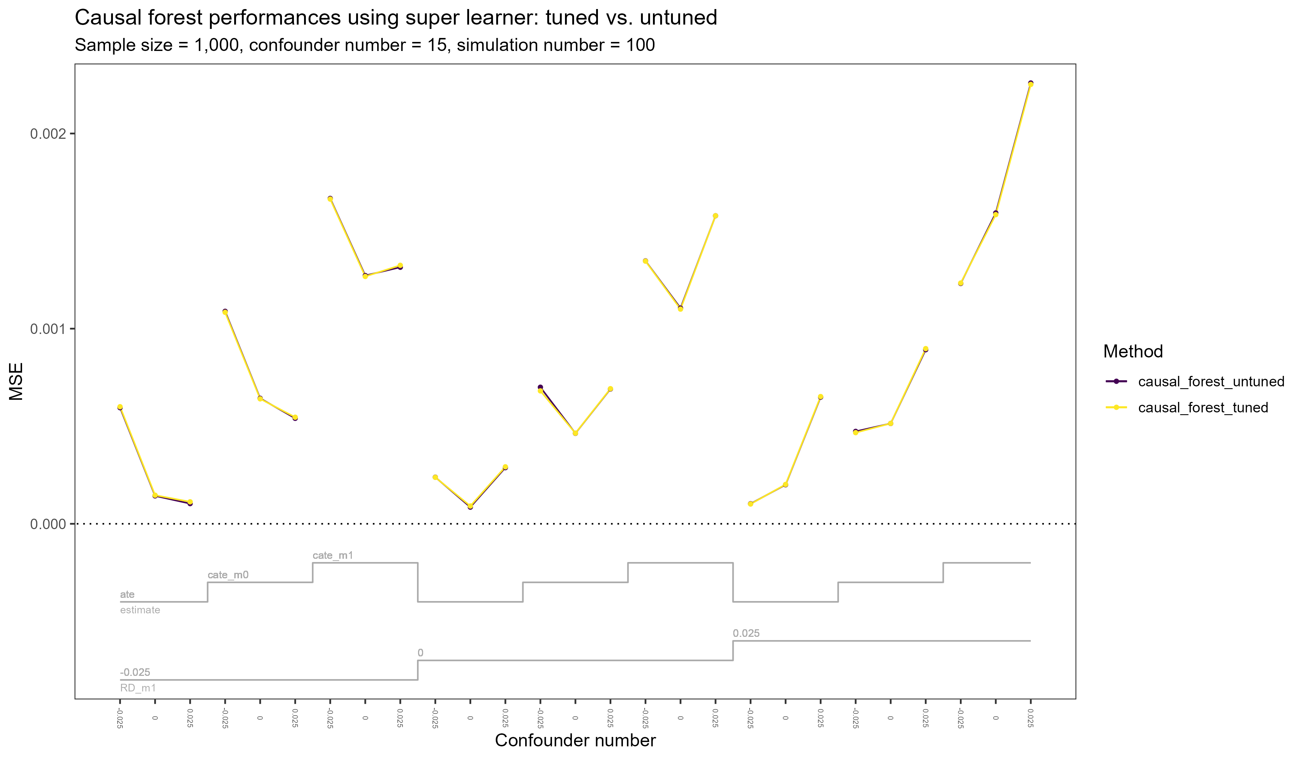

Slide 16
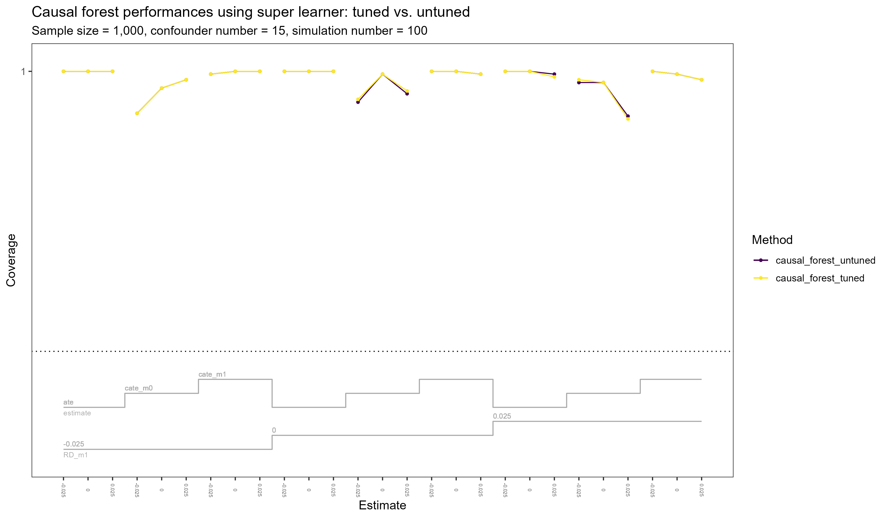

Slide 17
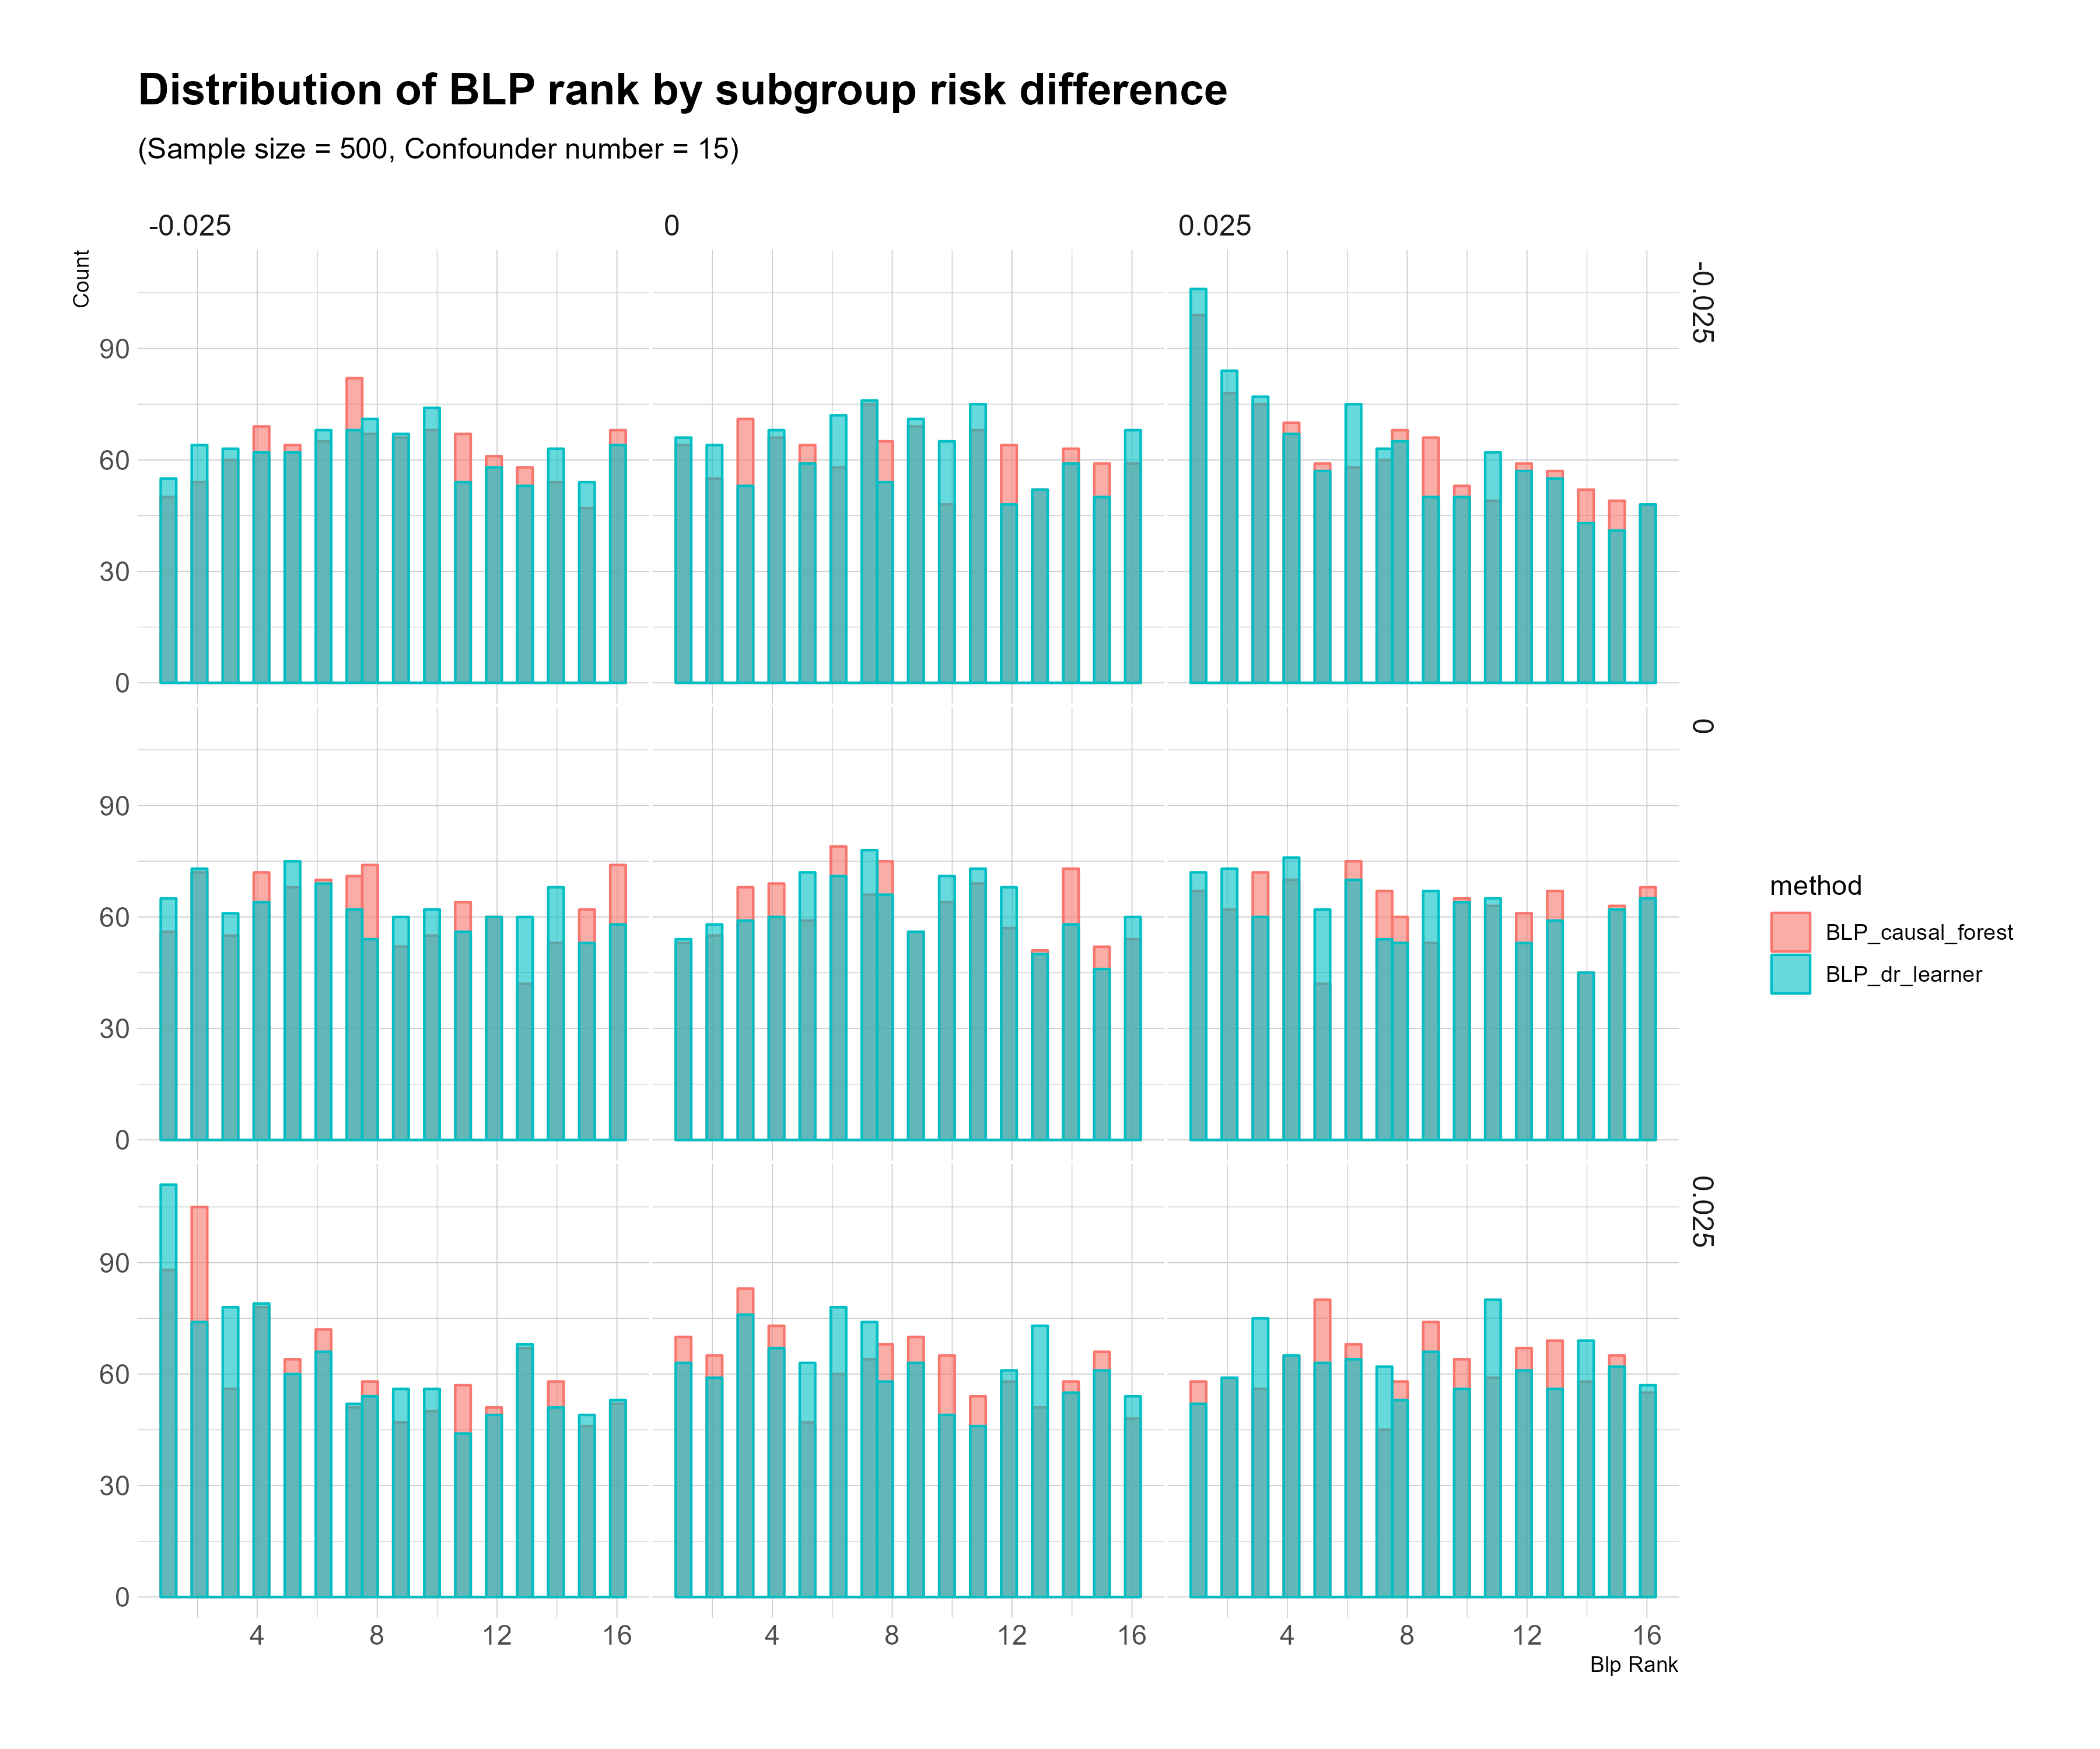

Slide 18
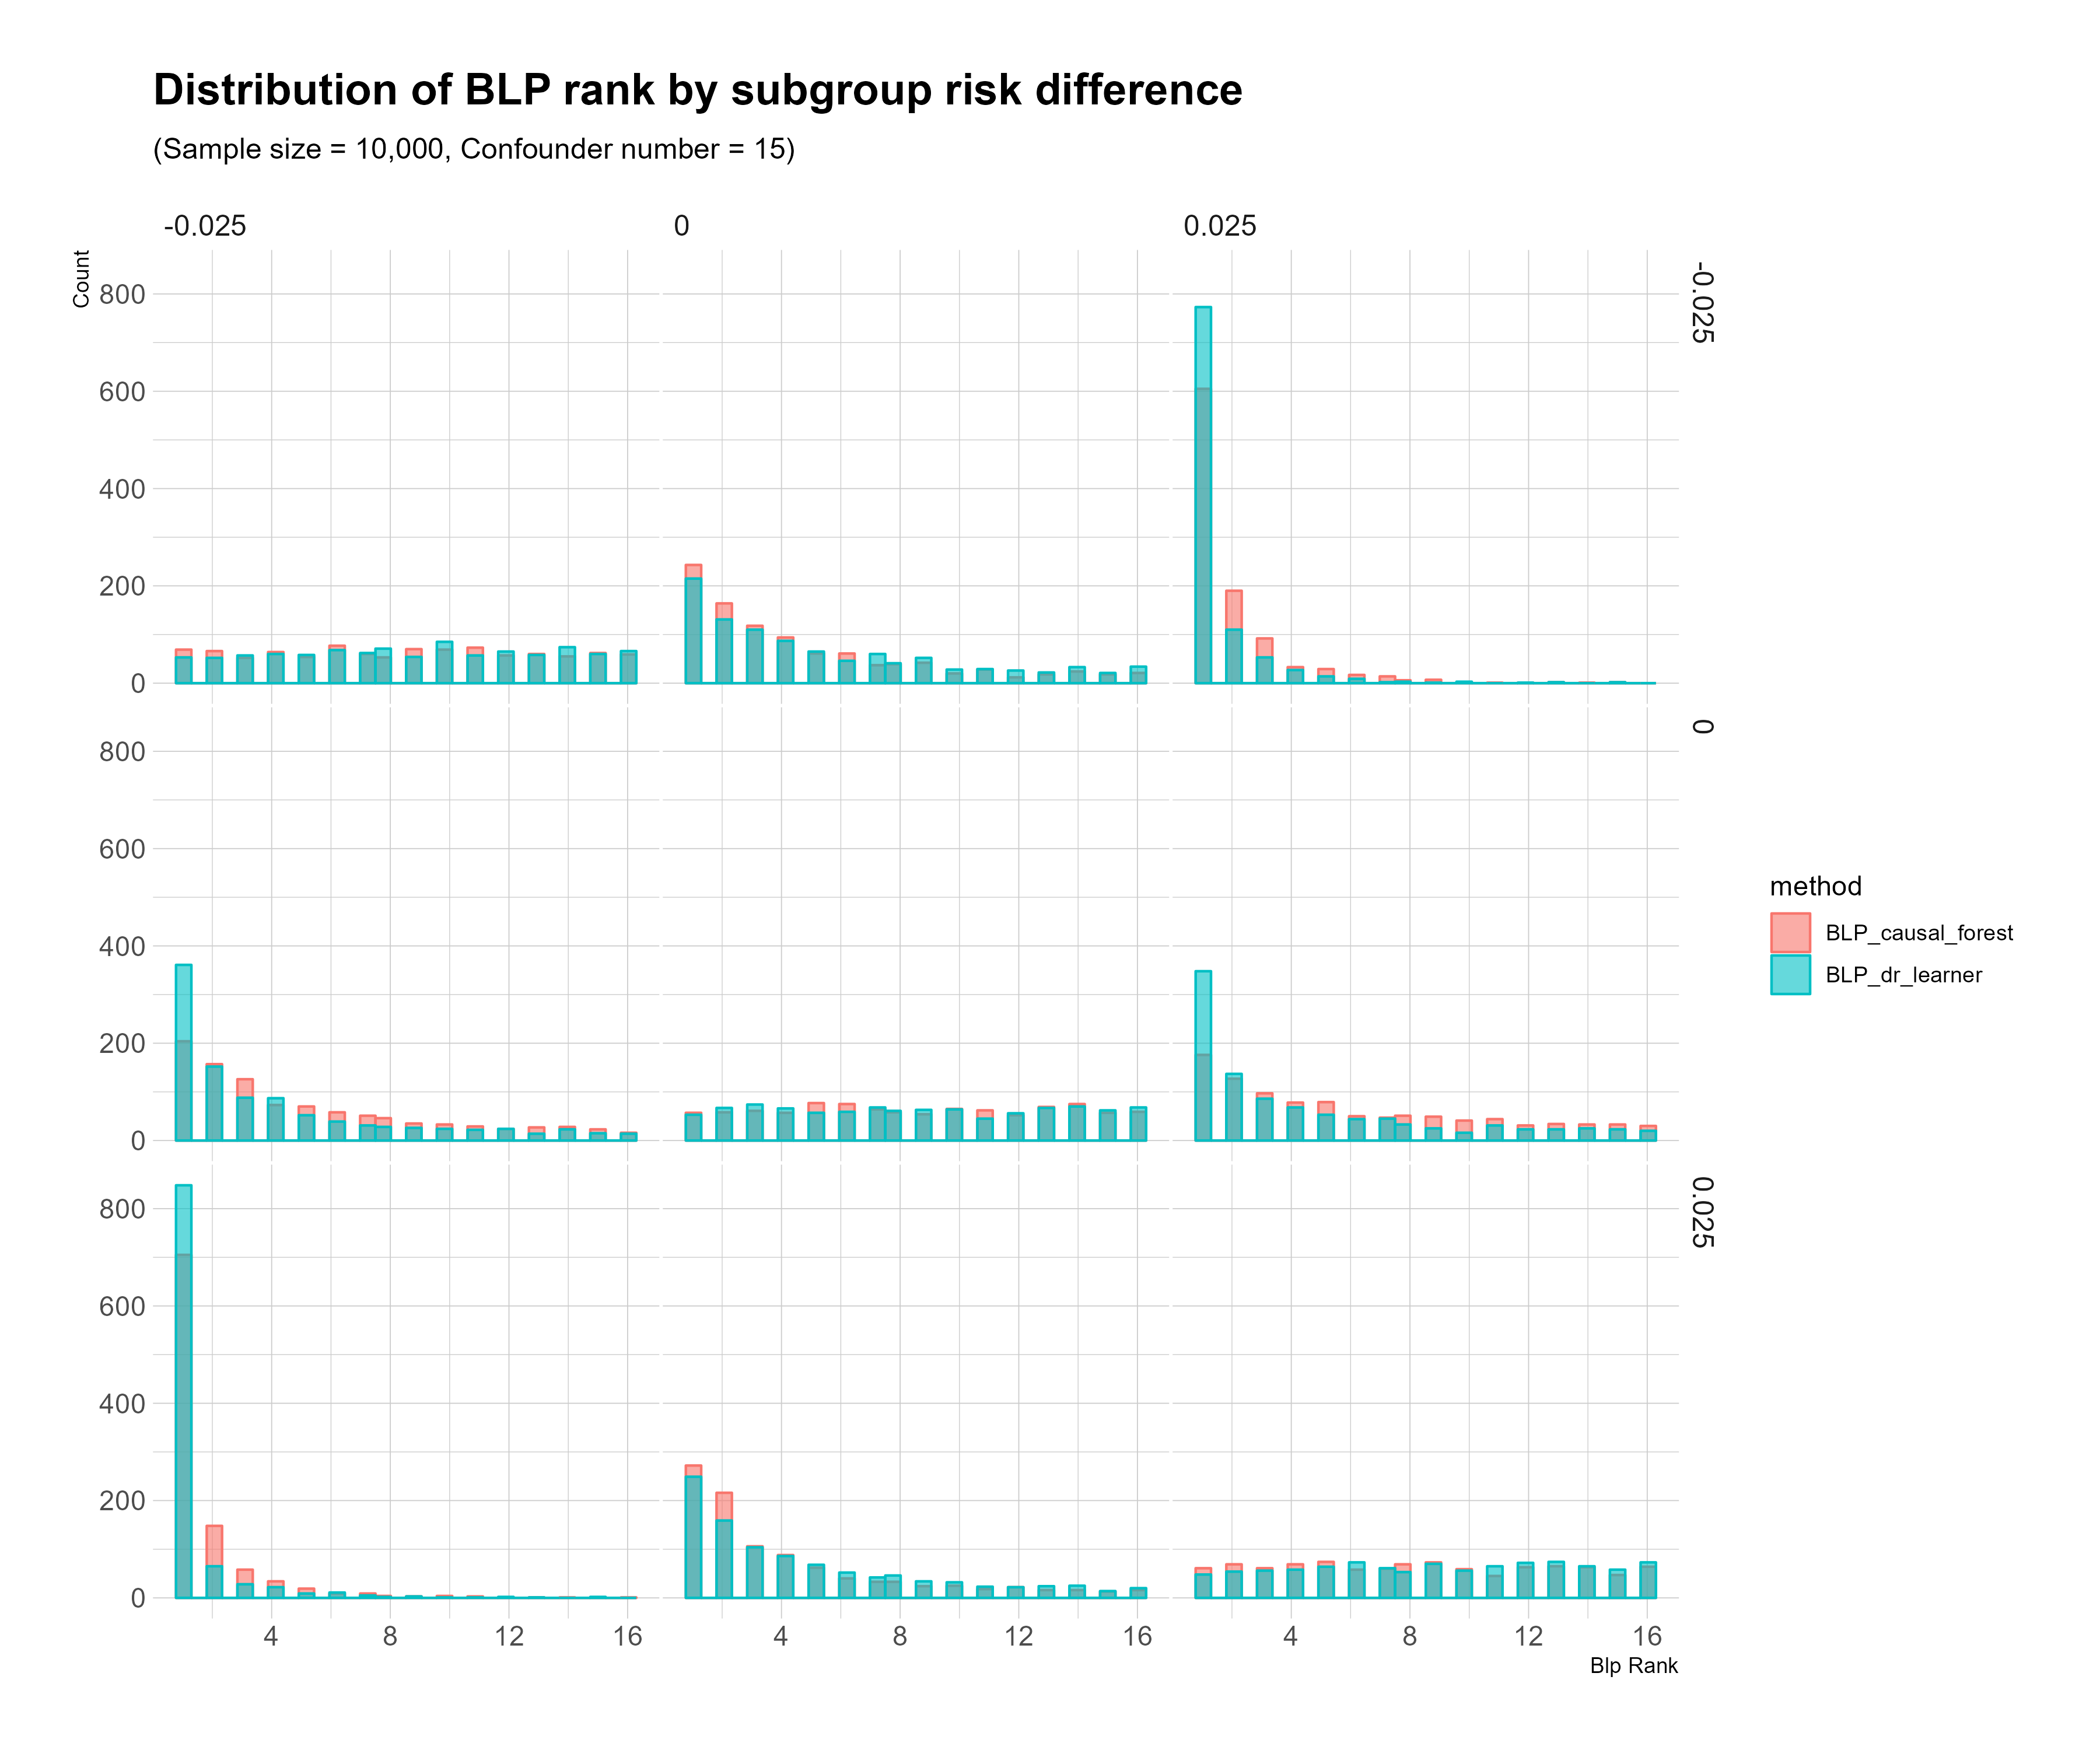

Slide 19
